Slide 1
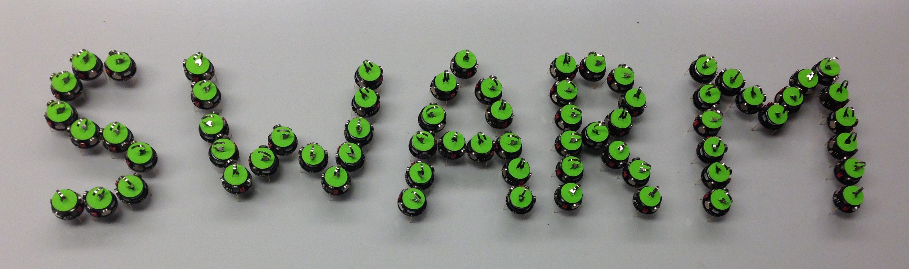
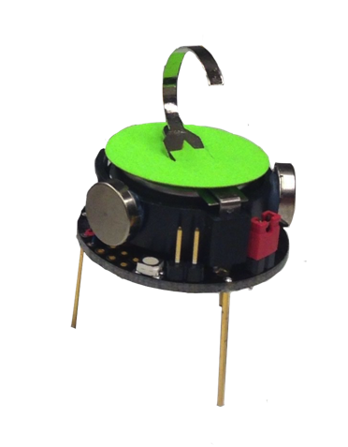




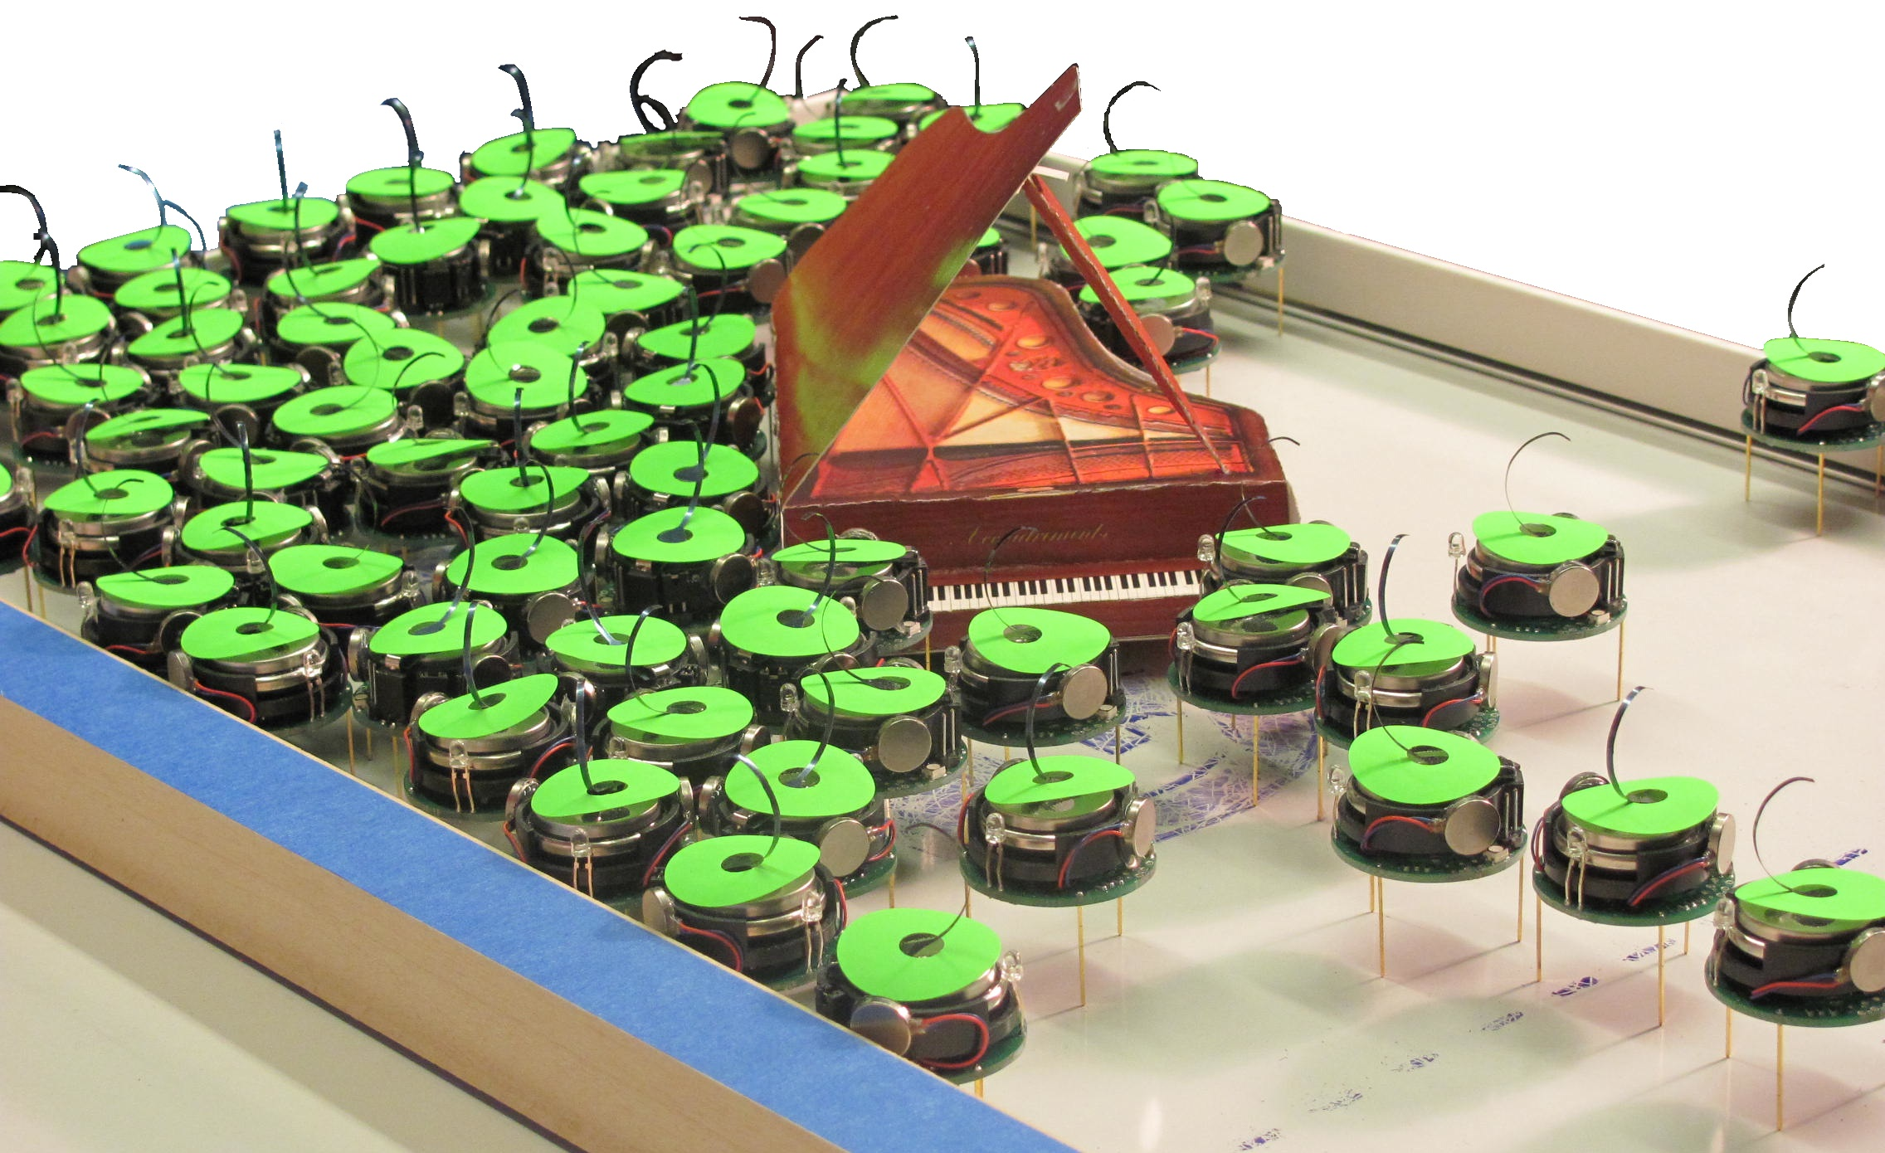

Object Manipulation and Position Control Using a Swarm With Global Inputs
Shiva Shahrokhi, Aaron T. Becker
sshahrokhi2@uh.edu, atbecker@uh.edu .
Department of Electrical and Computer Engineering,
University of Houston
Website, C.V.
YouTube channel
Actual Size
Why a Swarm?
Four Challenges With Increasing Complexity
Swarm robots:
Can pass through constrictions
Can bend around obstacles
Can be simple:
Easy to design, build, test
Disposable/ replaceable
Small, tiny, nano/micro robots
#1: Swarm torque control on pivoted object
#4: Line following with perpendicular orientation
Swarm Piano Mover’s video
Object Manipulation
Rules: Inputs are simple & global: all robots receive exactly the same commands
Goal: Position and orientation (pose) control of the pink object using the swarm force and torque
Simulation of robots exerting torque on a hinged “door”
Simulation of swarm orientation manipulation
(c) 97 hardware robots applying torque to an object
Grand Challenge: Pose Control
a) Pushing an object perpendicular to its minor axis, the swarm spreads around the object
b) Applying force perpendicular to the object's long axis reduces the probability of splitting the swarm
#2: Orientation control of the object
Manipulating the object to the desired pose
#3: Straight translation while regulating
object orientation
Experiment With Hardware Robots
Pure torque control experiments with kilobots
Kilobots are programmed to go toward the brightest light in the room as their global input

